Slide 1
Sentence-to-Book Classification
NLP Course Final Project

Slide 2
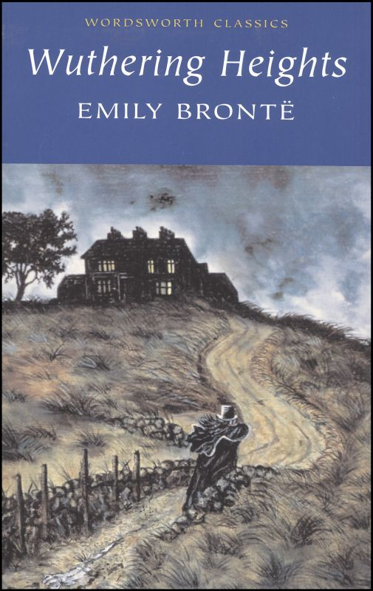

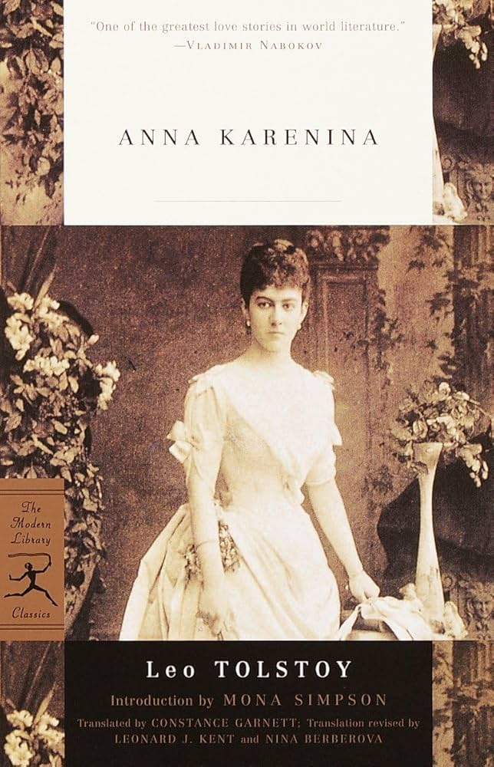
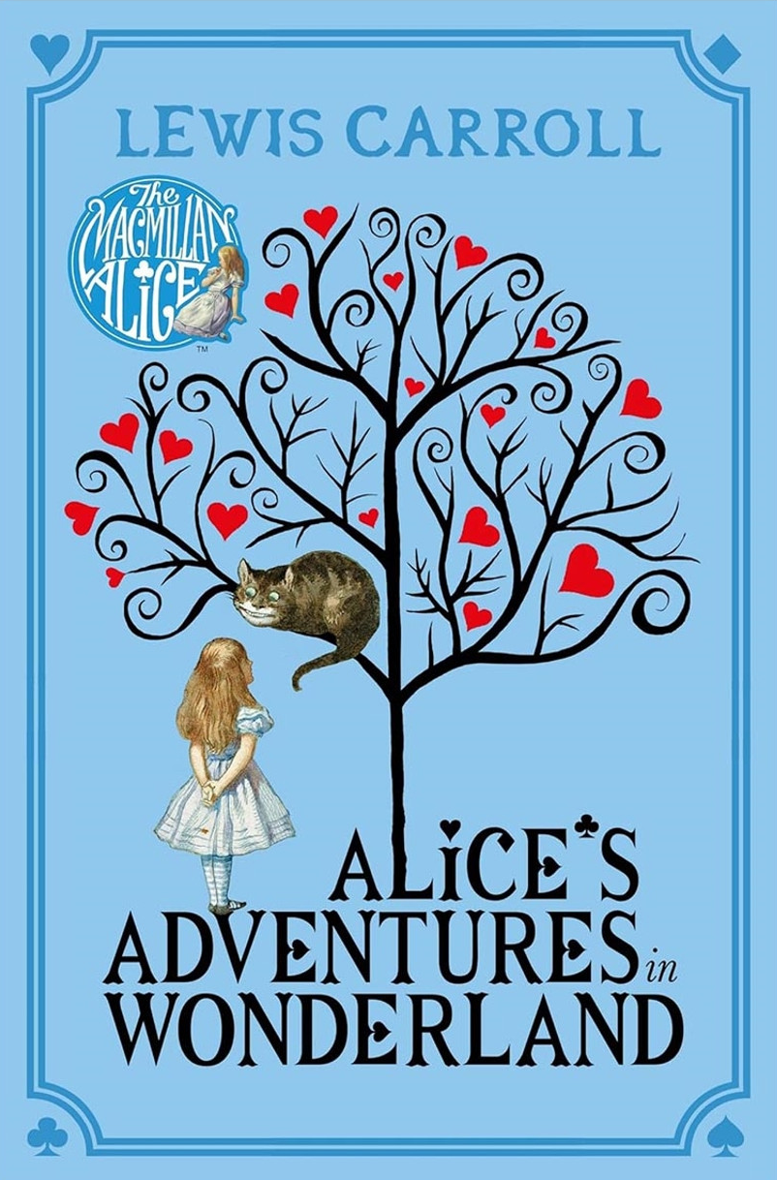
Introduction
Given a sentence, does it belong to the book?
No, I didn't, said Alice: I don t think it s at all a pity.

Slide 3
The Challange
The previous one was an easy one, but what about this?
But, away with you!
It comes from Wuthering Heights

Slide 4
The Challange
The previous was an easy one, but what about this?
But, away with you!
But Anna Karenina has a very similar sentence:
And go away, and go away!
It comes from Wuthering Heights
We want the model to understand the meaning of the sentences and classify them based on the meanings across the books.

Slide 5
The Challange
When two similar sentences are used once as a positive example and once as negative, it “confuses” the model
But, away with you!
And go away, and go away!

Slide 6
Our Goal
To train a model (or several models) that understands if a sentence belongs to the semantic realm of the book, even if it doesn’t actually appear in the book
But, away with you!

Slide 7
Why is that interesting?
A book is a constant corpus, so it is not that interesting, but our methodology can be applied on other corpora. For Example:
Filter out offensive comments from a web discoursed used by teenagers.
Automatic classification of Emails to folders.
Channelling user's requests to different departments.
… and many more applications where we want to classify signals to channels, when overlapping might occur, without tagging any data using self-supervised approach.

Slide 8
Our Methodology
Single-Label Data
Semantic Model
Multi-Label Data
Classifier(s)
We used semantic similarity to create an augmented dataset, that artificially “copy” sentences from one book to the other and train the classifier on that.

Slide 9
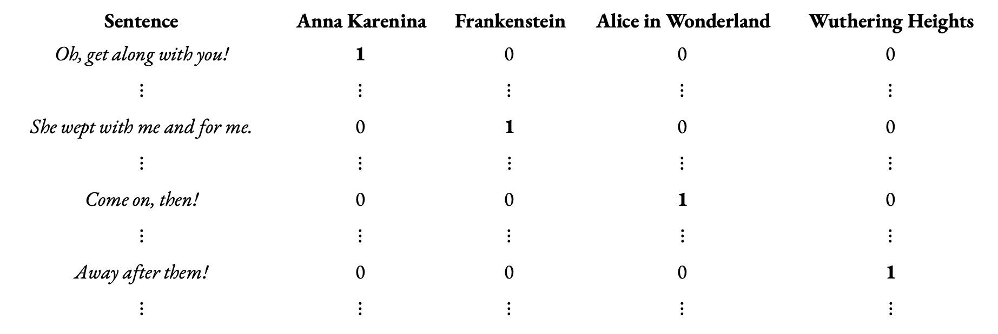
Single-Label Data
Sentence | Anna Karenina | Frankenstein | Alice in Wonderland | Wuthering Heights
Oh, get along with you! $$⋮$$ | 1 $$⋮$$ | 0 $$⋮$$ | 0 $$⋮$$ | 0 $$⋮$$
She wept with me and for me. $$⋮$$ | 0 $$⋮$$ | 1 $$⋮$$ | 0 $$⋮$$ | 0 $$⋮$$
Come on, then! $$⋮$$ | 0 $$⋮$$ | 0 $$⋮$$ | 1 $$⋮$$ | 0 $$⋮$$
Away after them! $$⋮$$ | 0 $$⋮$$ | 0 $$⋮$$ | 0 $$⋮$$ | 1 $$⋮$$
Source: IsmaelMousa/books
Single-Label Data
Semantic Model
Multi-Label Data
Classifier(s)

Slide 10
Semantic Model
We examined the performance of 4 pre-trained sentence transformers:
all-MiniLM-L6-v2
DistilBERT-based, 6-layer transformer
Dimension: 384
all-mpnet-base-v2
MPNet-based (Masked and Permuted Pre-training)
Dimension: 768
paraphrase-multilingual-MiniLM-L12-v2
DistilBERT-based, 12-layer transformer, multilingual
Dimension: 384
paraphrase-MiniLM-L3-v2
DistilBERT-based, 3-layer transformer
Dimension: 384
We prioritized Accuracy, Efficiency and Speed.
Single-Label Data
Semantic Model
Multi-Label Data
Classifier(s)

Slide 11
Choosing the Semantic Model
We used Gen-AI to generate semantically similar sentences to real sentences from the books. We then fed them to the models and used their similarity scores to test the accuracy.
all-MiniLM-L6-v2
93.75%
all-mpnet-base-v2
97.5%
paraphrase-multilingual-MiniLM-L12-v2
98.75%
paraphrase-MiniLM-L3-v2
90%
⭐
Single-Label Data
Semantic Model
Multi-Label Data
Classifier(s)

Slide 12
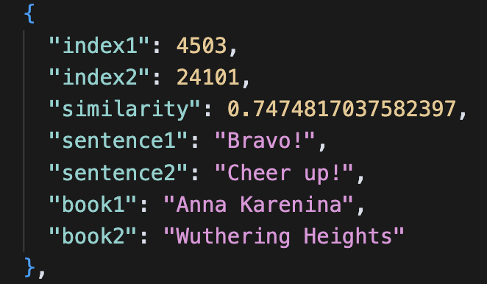
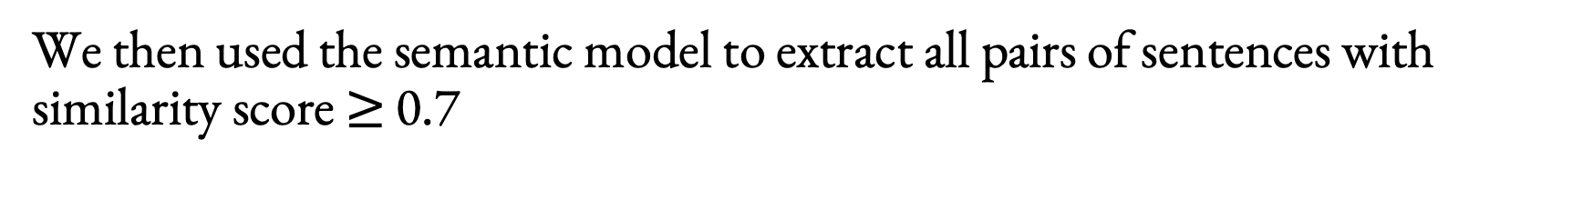
Label Engineering
We then used the semantic model to extract all pairs of sentences with similarity score $≥$ 0.7
Single-Label Data
Semantic Model
Multi-Label Data
Classifier(s)

Slide 13
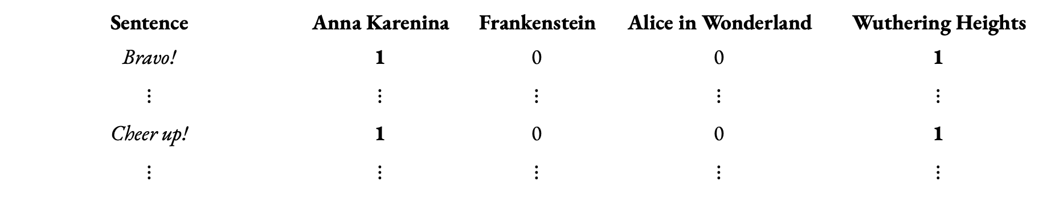
Label Engineering
And used the similarity pairs to create a new dataset where each sentence belong not only to the book it originally comes from but also to any other book that has a similar sentence in it
Sentence | Anna Karenina | Frankenstein | Alice in Wonderland | Wuthering Heights
Bravo! $$⋮$$ | 1 $$⋮$$ | 0 $$⋮$$ | 0 $$⋮$$ | 1 $$⋮$$
Cheer up! $$⋮$$ | 1 $$⋮$$ | 0 $$⋮$$ | 0 $$⋮$$ | 1 $$⋮$$
Single-Label Data
Semantic Model
Multi-Label Data
Classifier(s)

Slide 14
Label Engineering
We also sampled the dataset to achieve balance between the book and prioritized multi-label sentences to accelerate learning of the overlap pattern
Original Dataset
Total sentences: 31,760
Unique sentences: 31,667 (93 duplicates removed)
Augmented Dataset
Total sentences: 10,121
Multi-label samples: 5,154 sentences (50.9%)
Single-label samples: 4,967 sentences (49.1%)
Single-Label Data
Semantic Model
Multi-Label Data
Classifier(s)

Slide 15
The Classifier(s)
We tested two approaches. In both cases the model is a multi layer perceptron:
Multi-Label Classifier
Pros:
More efficient (training and prediction)
Cons:
Capture dependencies between all 4 books even if they do not exist
Predict for all books even if not needed
4 Binary Classifiers
Pros:
Allow per book prediction
Can be fine-tuned and optimized for each book separately
Cons:
4 times slower to train
Single-Label Data
Semantic Model
Multi-Label Data
Classifier(s)

Slide 16
A Single-Label Example
No, I didn’t, said Alice: I don t think it s at all a pity.
 | True Label | Prediction
Anna Karenina | 0 | 0.103 (0) | ✓
Frankenstein | 0 | 0.009 (0) | ✓
Alice in Wonderland | 1 | 0.977 (1) | ✓
Wuthering Heights | 0 | 0.111 (0) | ✓
Single-Label Data
Semantic Model
Multi-Label Data
Classifier(s)

Slide 17
A Single-Label Example
I would have made a pilgrimage to the highest peak of the Andes, could I, when there, have precipitated him to their base.
 | True Label | Prediction
Anna Karenina | 0 | 0.008 (0) | ✓
Frankenstein | 1 | 0.994 (1) | ✓
Alice in Wonderland | 0 | 0.004 (0) | ✓
Wuthering Heights | 0 | 0.024 (0) | ✓
Single-Label Data
Semantic Model
Multi-Label Data
Classifier(s)

Slide 18
A Multi-Label Example
he asked.
 | True Label | Prediction |  | Real sentence from the book
Anna Karenina | 1 | 0.993 (1) | ✓ | he questioned.
Frankenstein | 0 | 0.242 (0) | ✓
Alice in Wonderland | 1 | 0.940 (1) | ✓ | he asked.
Wuthering Heights | 1 | 0.988 (1) | ✓ | I asked.
Single-Label Data
Semantic Model
Multi-Label Data
Classifier(s)

Slide 19
A Multi-Label Example
she continued.
 | True Label | Prediction |  | Real sentence from the book
Anna Karenina | 1 | 0.941 (1) | ✓ | She stood still again.
Frankenstein | 0 | 0.109 (0) | ✓
Alice in Wonderland | 1 | 0.781 (1) | ✓ | Presently she began again.
Wuthering Heights | 1 | 0.976 (1) | ✓ | she continued.
Single-Label Data
Semantic Model
Multi-Label Data
Classifier(s)

Slide 20
Comparison
The difference is very small and might change with the choice of different hyper-parameters. Hence, the choice really depends on the application’s needs
Single-Label Data
Semantic Model
Multi-Label Data
Classifier(s)

Slide 21
Multi-Label Classifier Results
 | Overall Accuracy | Overall F1 | Single-Label F1 | Multi-Label F1
Anna Karenina | 0.881 | 0.879 | 0.393 | 0.922
Frankenstein | 0.848 | 0.829 | 0.911 | 0.678
Alice in Wonderland | 0.877 | 0.748 | 0.864 | 0.662
Wuthering Heights | 0.845 | 0.845 | 0.597 | 0.894
Single-Label Data
Semantic Model
Multi-Label Data
Classifier(s)

Slide 22
4 Binary Classifiers Results
 | Overall Accuracy | Overall F1 | Single-Label F1 | Multi-Label F1
Anna Karenina | 0.884 | 0.885 | 0.403 | 0.933
Frankenstein | 0.857 | 0.840 | 0.910 | 0.719
Alice in Wonderland | 0.895 | 0.802 | 0.853 | 0.770
Wuthering Heights | 0.849 | 0.851 | 0.586 | 0.906
Single-Label Data
Semantic Model
Multi-Label Data
Classifier(s)

Slide 23
The Naïve Basleine
We also trained the same architecures with the single-label dataset for benchmarking:
~0.25%
The naïve classifiers are only sligtly better at predicting unique sentences, but the non-naïve models are dramatically better at predicting generic or shared sentences.
Single-Label Data
Semantic Model
Multi-Label Data
Classifier(s)

Slide 24
Discussion

Slide 25
Future Steps
Transformer based architecture for more complex pattern and across-sentences dependencies.
Manual filtering of the similarity pairs to prevents “dirty” data.
Henance semantic seperation using constractive learning.
Fine-Tune the semantic model.

